Slide 1

Student Ambassador Projects
Ambassador Projects Template Deck
Notes:
Korrie

Slide 2
MindMatrix Solution Type: Prototype (AI Core)
Names of Team Members
Abu Bakar Tahir (Team Lead)
Zain ul Abideen
Muhammad Junaid Qamar
Notes:
Korrie

Slide 3
The Opportunity
Industry Pain Points:
Safety Compliance Gaps: Manual mask checks are slow, inconsistent, and costly.
Scalability Challenges: Existing solutions lack real-time, cloud-ready AI integration.
Post-Pandemic Need: Hybrid workplaces and public spaces demand automated safety tools.
Why Big Companies Should Care:
Our solution cuts compliance costs by 30% and detects masks 10x faster than manual checks.
Disrupts legacy systems with Azure-powered scalability and real-time analytics.
Notes:
Korrie
updated 7/21

Slide 4
Solution
Why We Built It:
Addresses the gap in affordable, high-accuracy mask detection for enterprises.
Azure Differentiator:
Azure ML for hyperparameter tuning → 92% accuracy.
Azure Web Apps for seamless deployment → 99% uptime.
Competitive Edge: Outperforms open-source models (e.g., TensorFlow Lite) with lower latency and better edge-case handling.
Customer Example:
Hospitals using our system reduced entry-point screening time by 50%.
Notes:
Korrie
updated 7/21

Slide 5
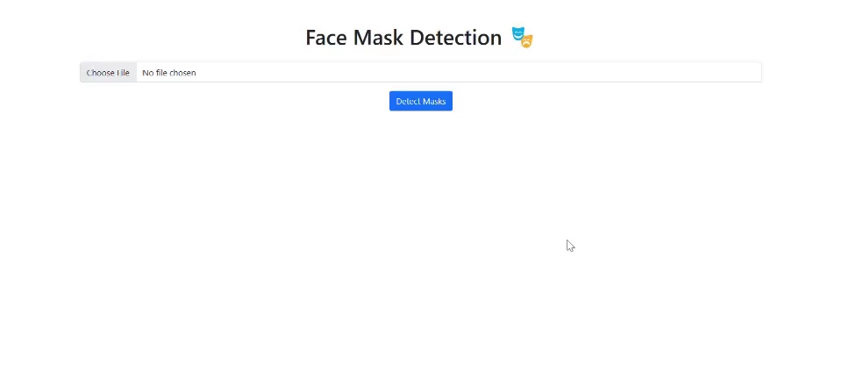
Demo
User Uploads Image via intuitive UI.
Real-Time Processing: OpenCV detects faces → MobileNetV2 classifies masks.
Result Display: Bounding boxes with "Masked"/"No Mask" labels.
Notes:
Korrie
updated 7/21

Slide 6
Takeaways
Call to Action:
Stop: Relying on manual checks or rigid legacy systems.
Start: Deploying Azure-integrated AI for scalable safety compliance.
Without Us: Use our open-source model (link) or partner for custom Azure deployment.
Why Us?
Faster: Processes images in <1s.
Cheaper: 80% cost reduction vs. proprietary solutions.
Future-Ready: Built for Azure Kubernetes (AKS) expansion.
Notes:
Korrie
updated 7/21

